Slide 1
Introduction to Computing for Data Analysis
Does my (numerical) program compute the right answer?
Richard Vuduc, Ph.D.
Associate Professor
School of Computational Science and Engineering
Rounding errors
Notes:
While a real number might have an infinite number of digits, we have to store values in a finite way on a computer.
As such, there will necessarily be errors and approximations.
In this lesson, I want you to think about how certain kinds of arithmetic errors called *rounding errors.*

Slide 2
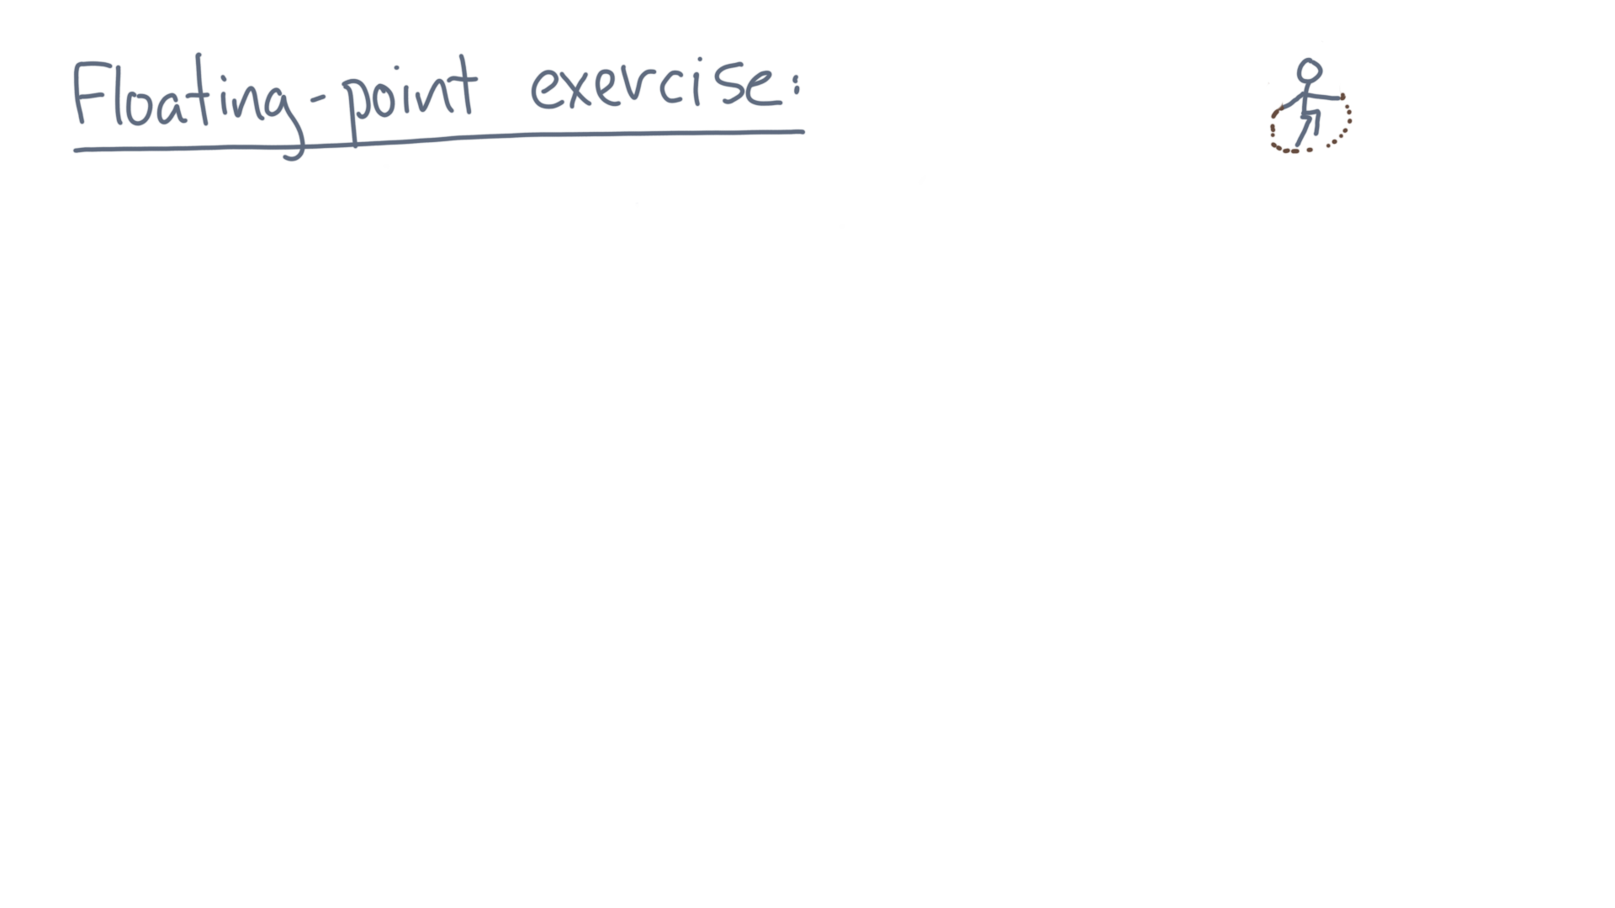
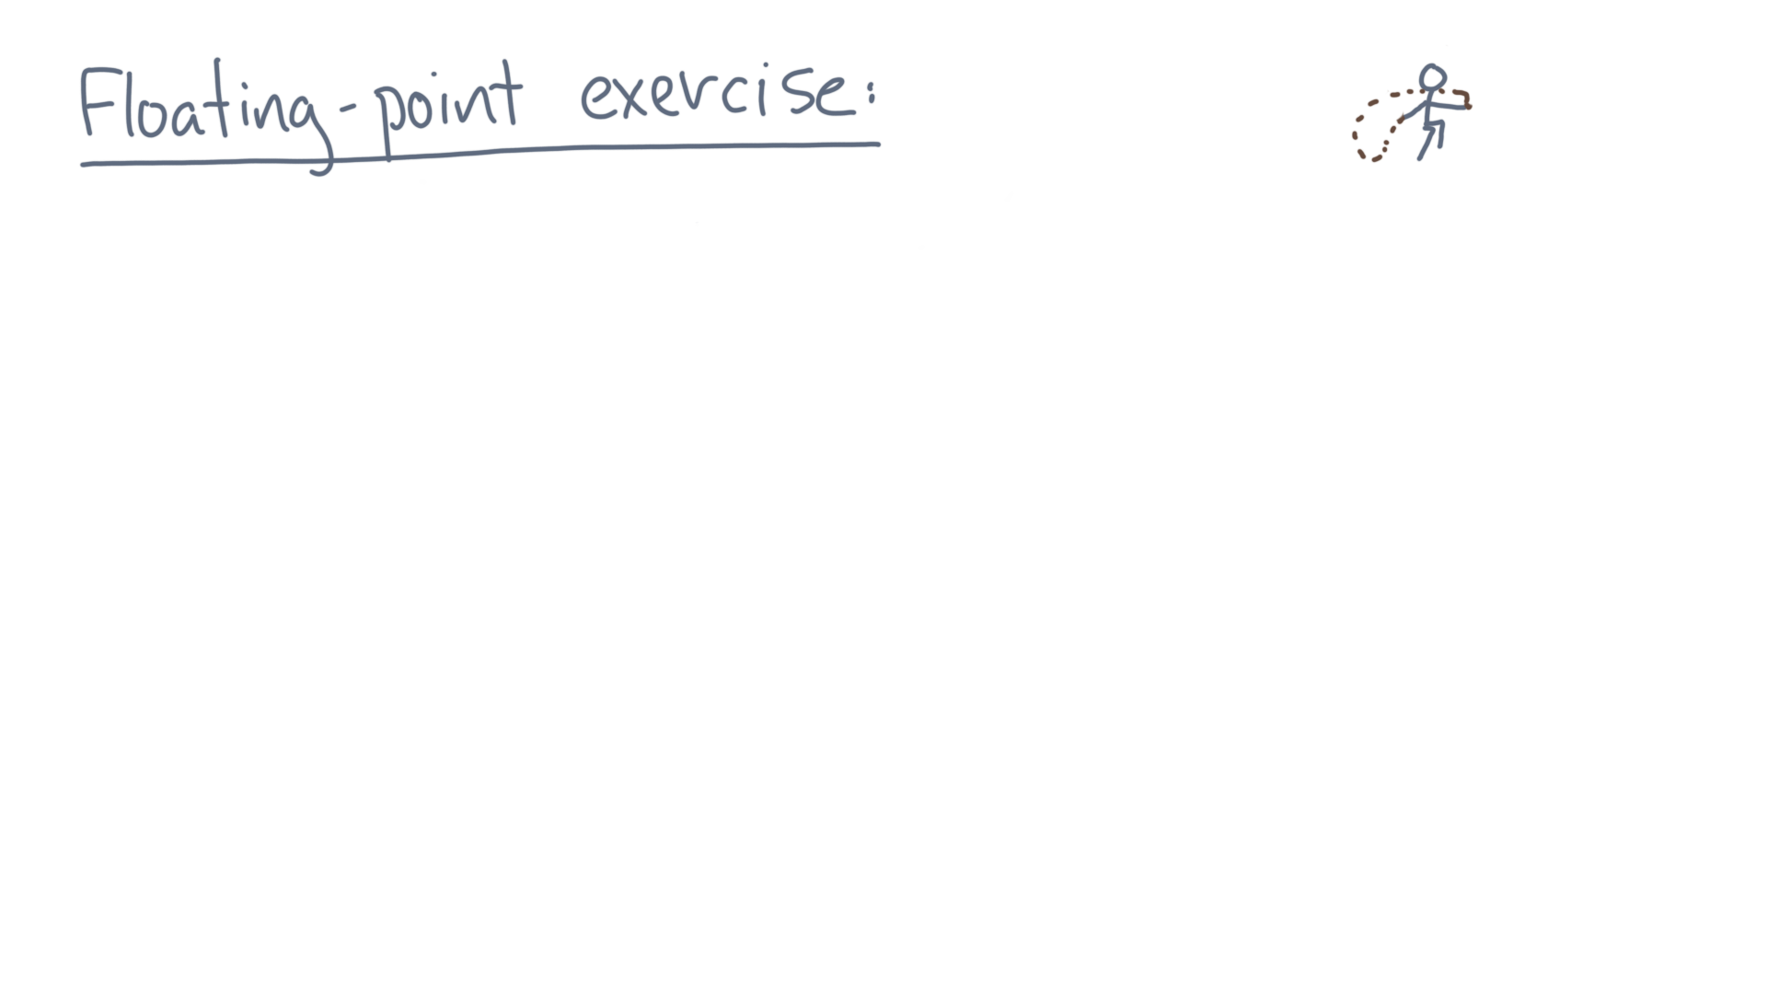
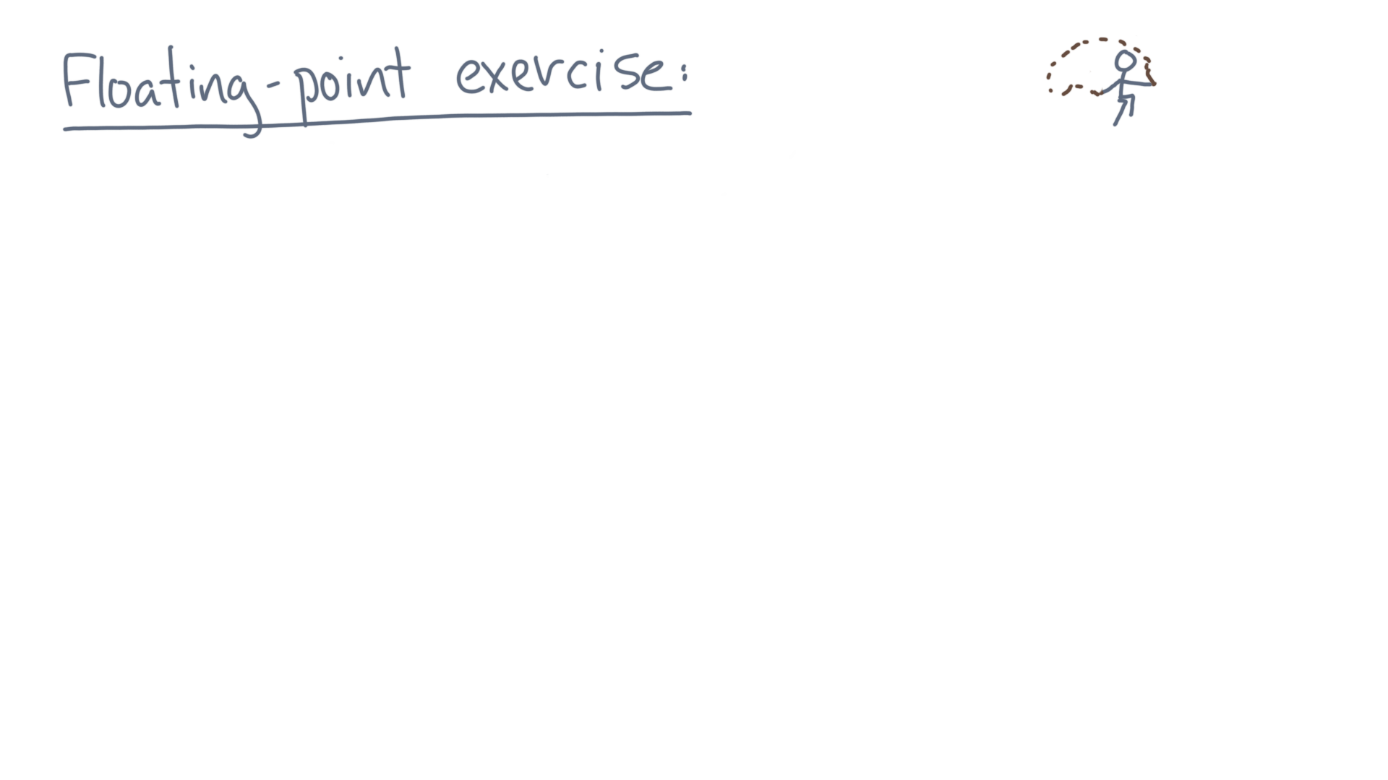
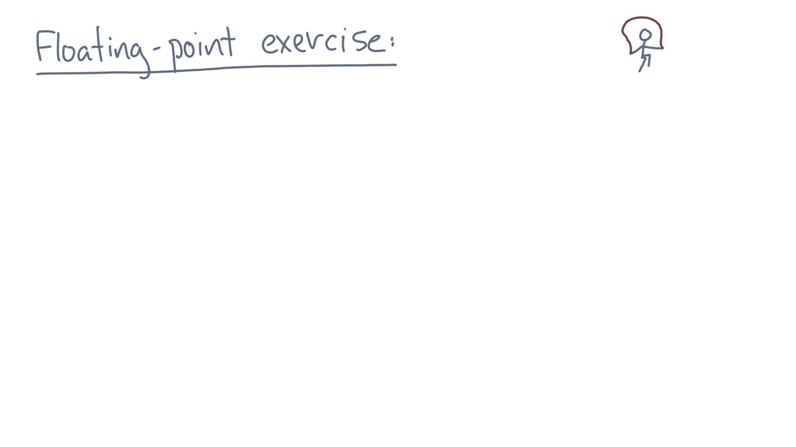
Notes:
The simplest way to see this is with a little exercise.

Slide 3
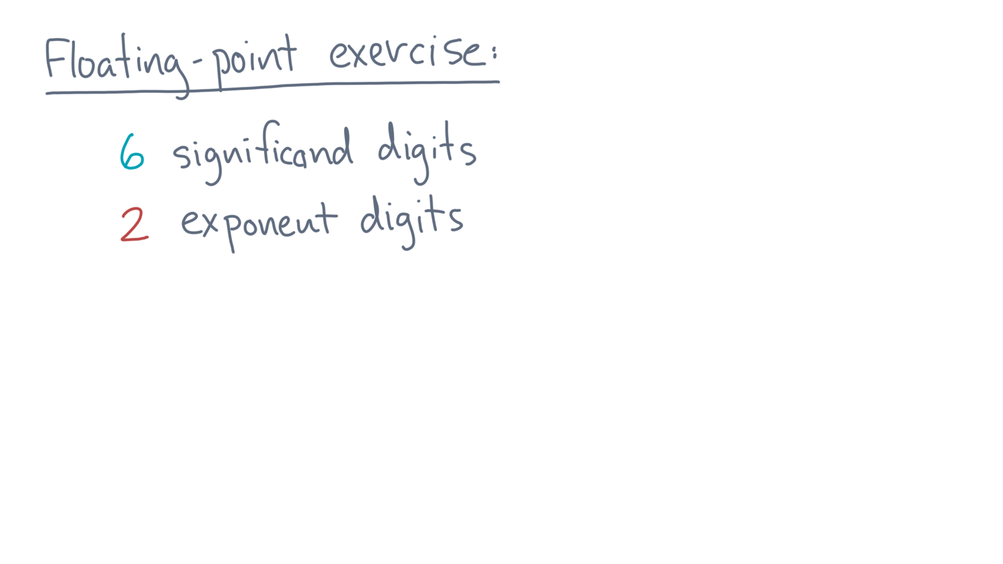
Notes:
Consider a base-ten floating-point value with 6 significand digits and 2 exponent digits.

Slide 4
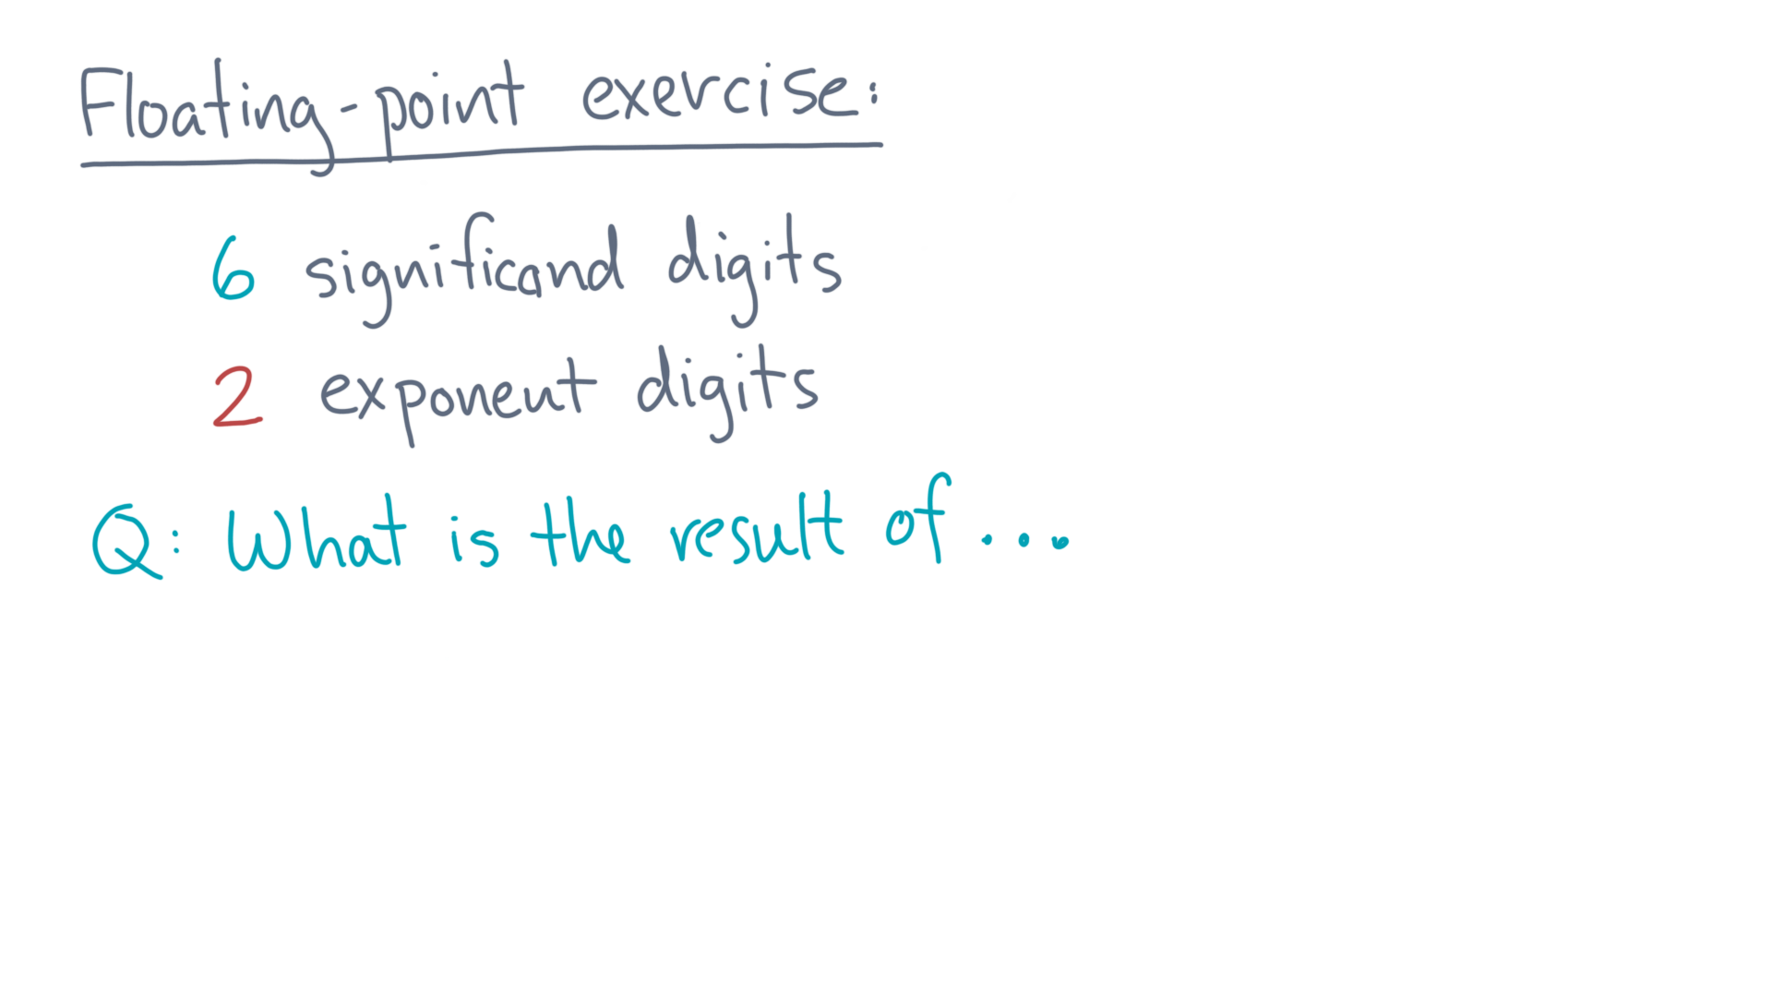
Notes:
Here is my question.

Slide 5
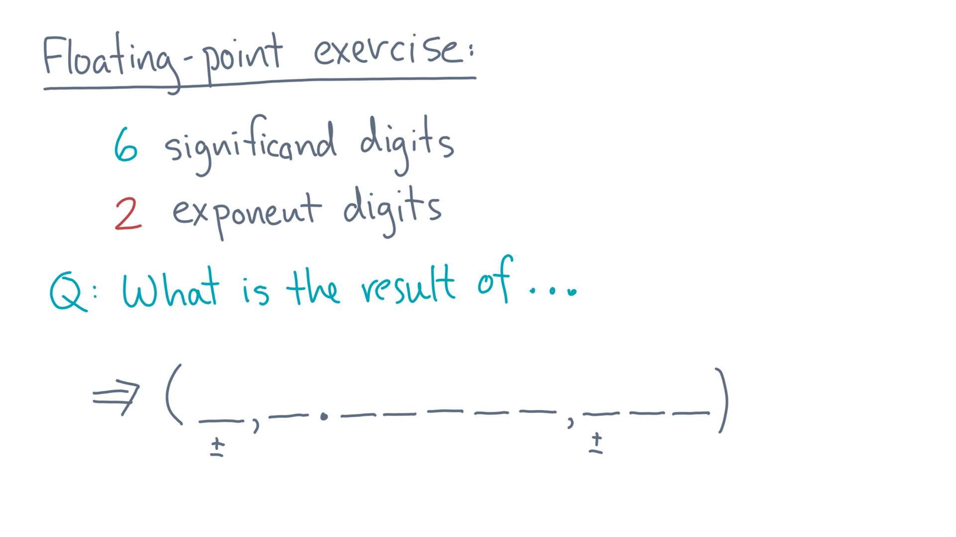
Notes:
What is the output for the following operation?

Slide 6
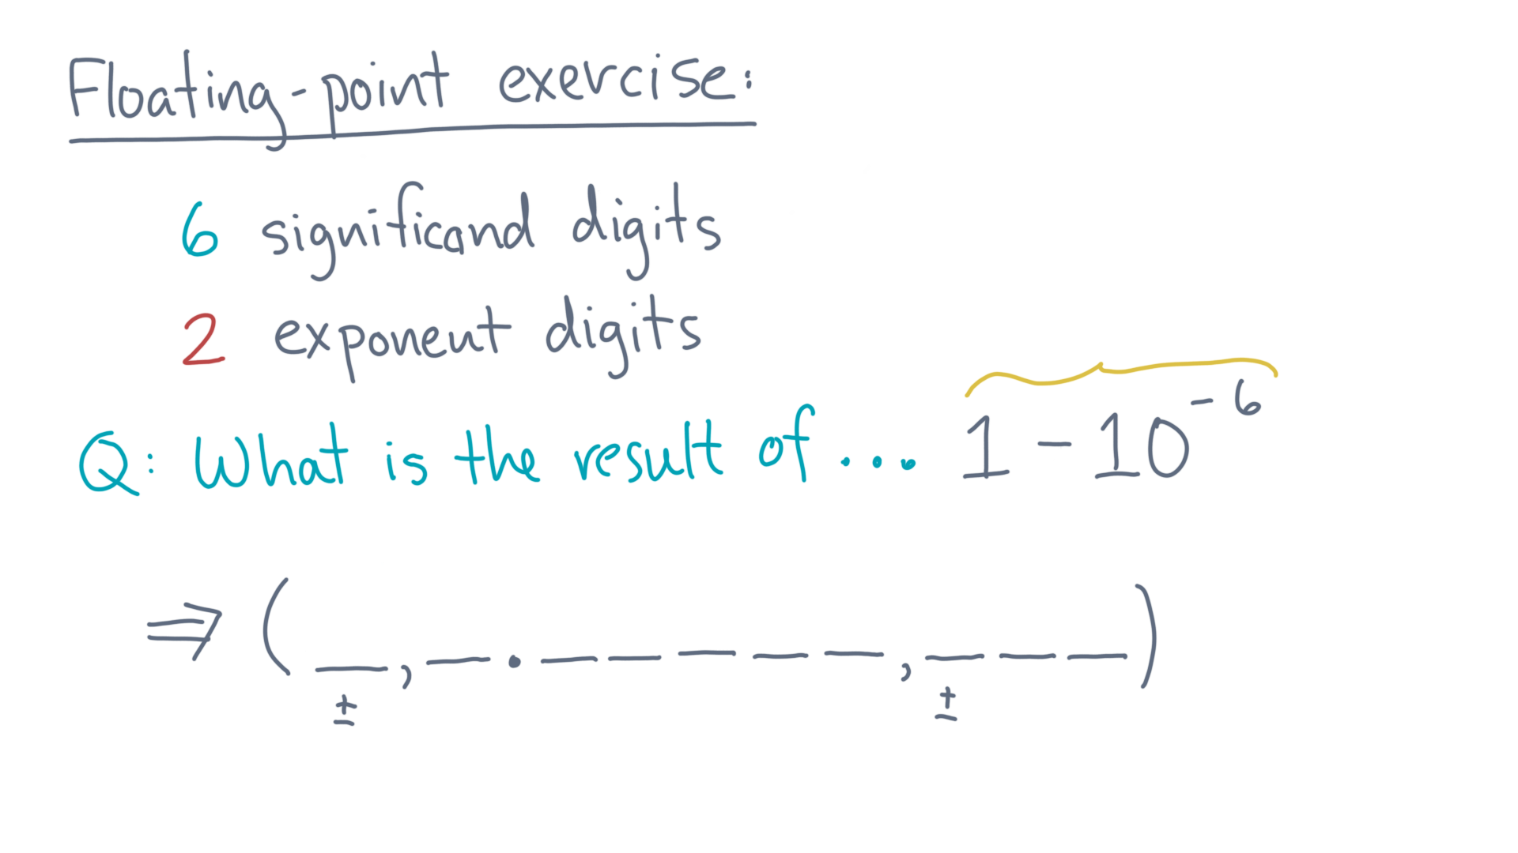
Notes:
One *minus* 10 to the power minus 6?
Start with the exact answer.

Slide 7
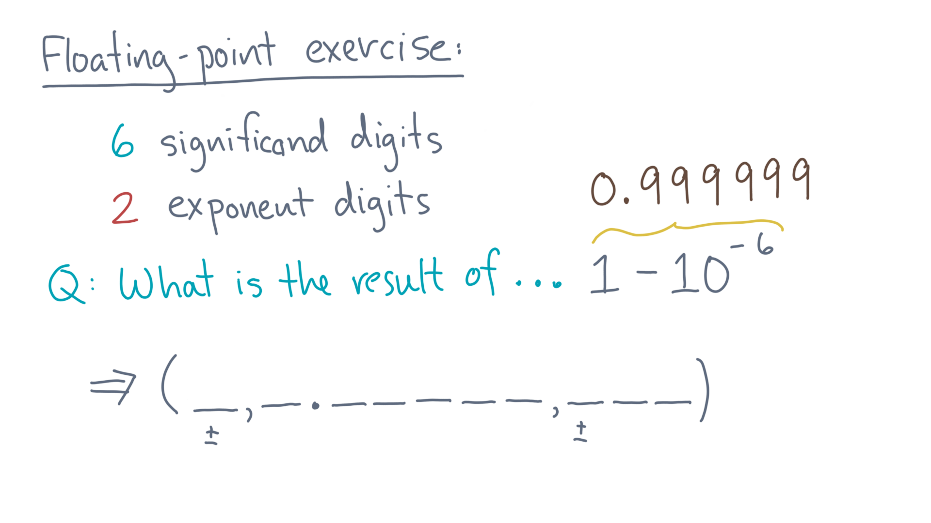
Notes:
That’s 0.999, 999.

Slide 8
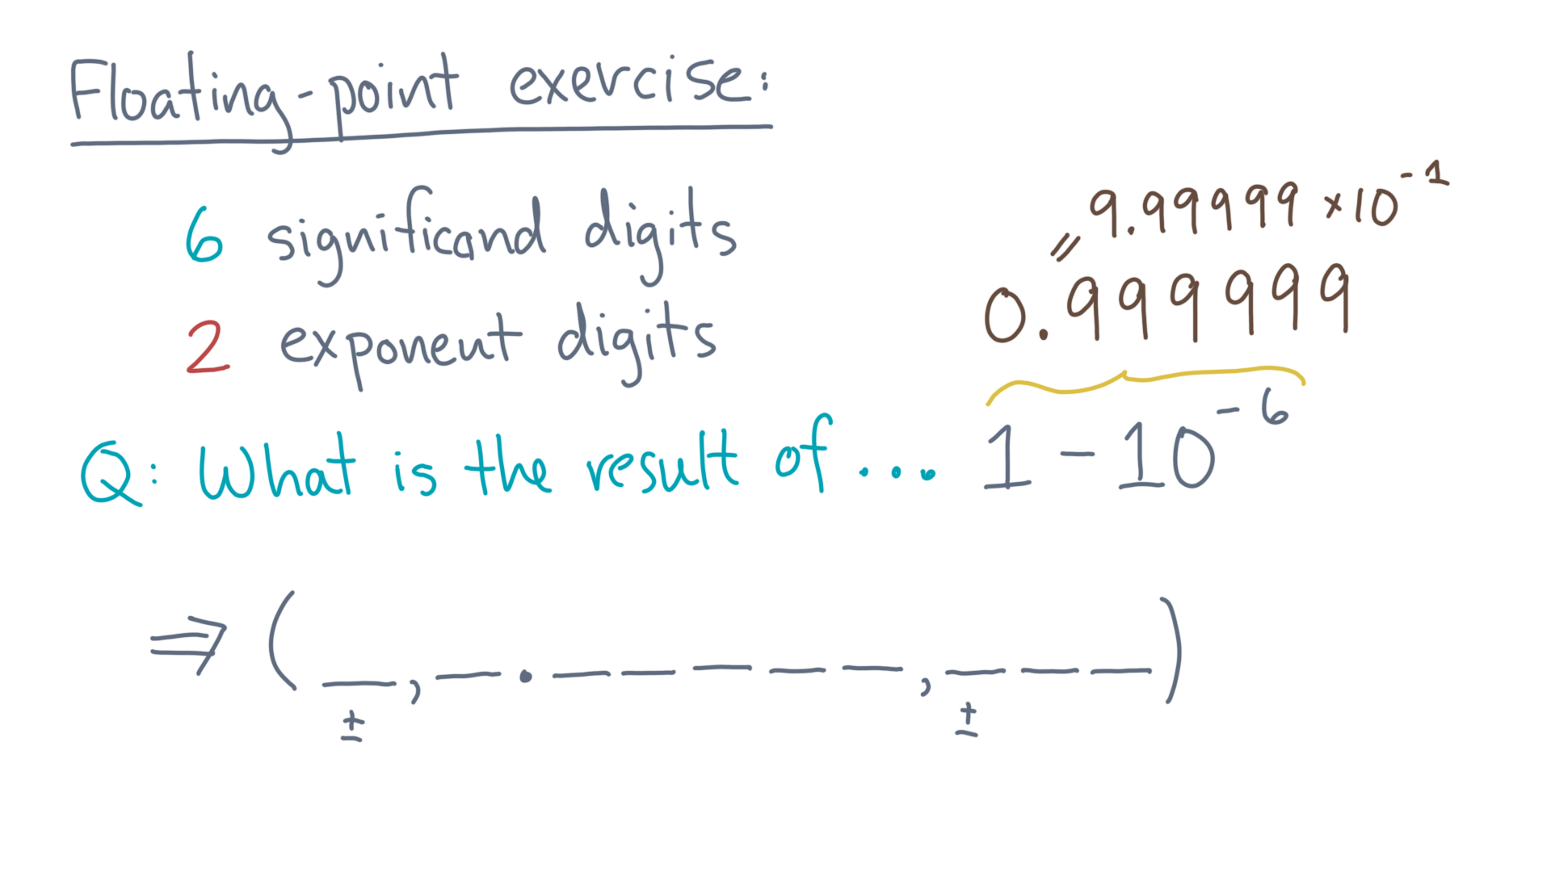
Notes:
In scientific notation, that’s 9.99 999, times ten to the minus 1.
You can fill in the floating-point representation accordingly.

Slide 9
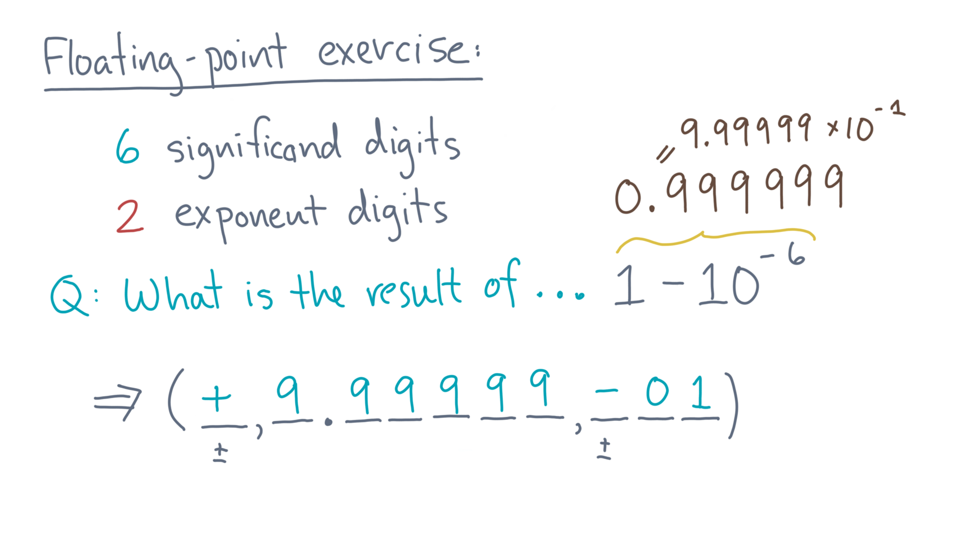
Notes:
The sign is plus.
The significand is 9 point 9-9, 9-9-9.
And the exponent is minus 0-1.

Slide 10
Notes:
Ok, let’s try another one.

Slide 11

Notes:
What’s 1 plus 10 to the minus 6, in floating-point?
You can start as before with the exact answer.

Slide 12
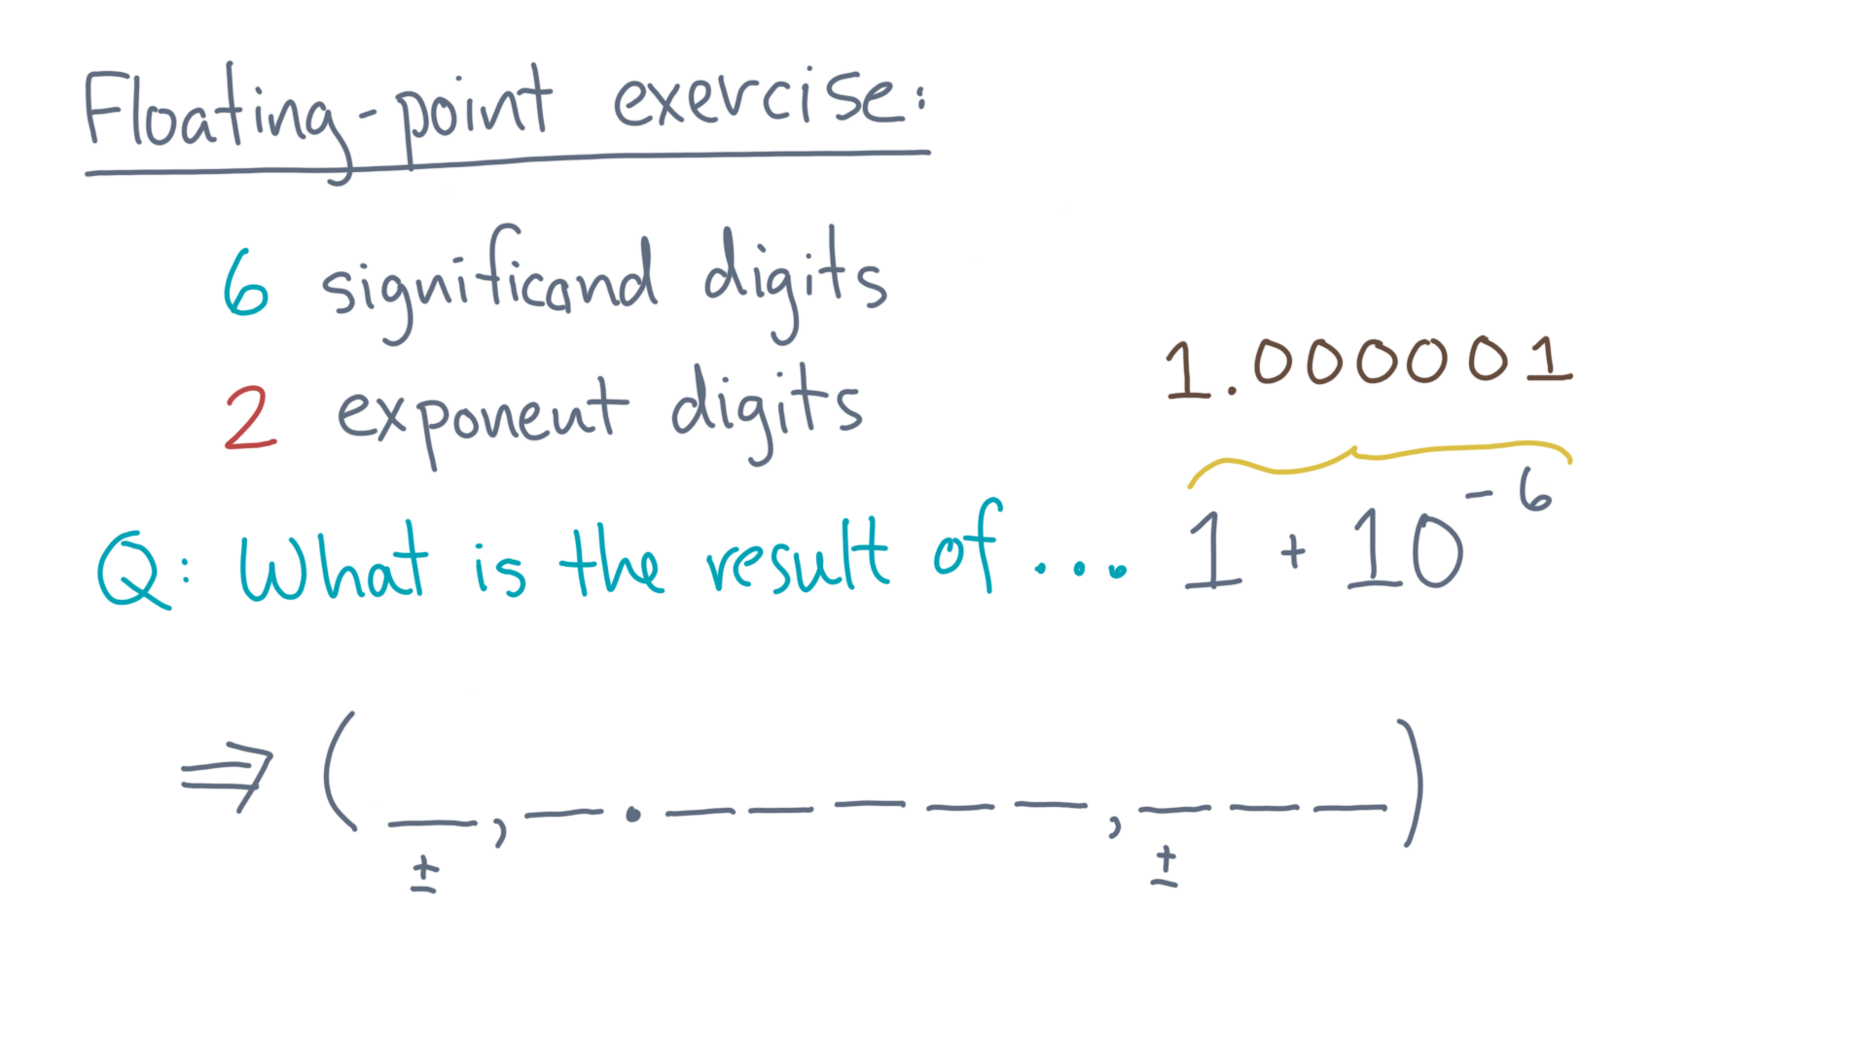
Notes:
That’s 1 point 0-0, 0-0-0 1.

Slide 13
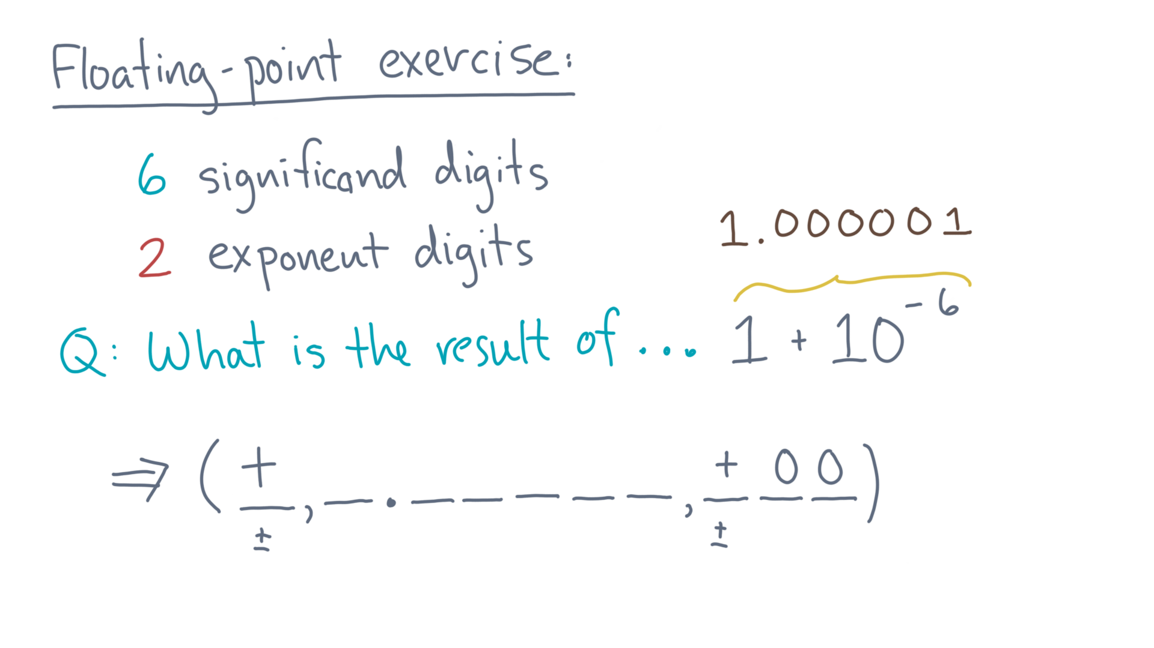
Notes:
So the sign is plus and the exponent is plus 0-0.
But what about the significand?

Slide 14

Notes:
Well, you only have 6 places whereas the true answer needs 7.
That’s too bad – you can only store what you can!

Slide 15
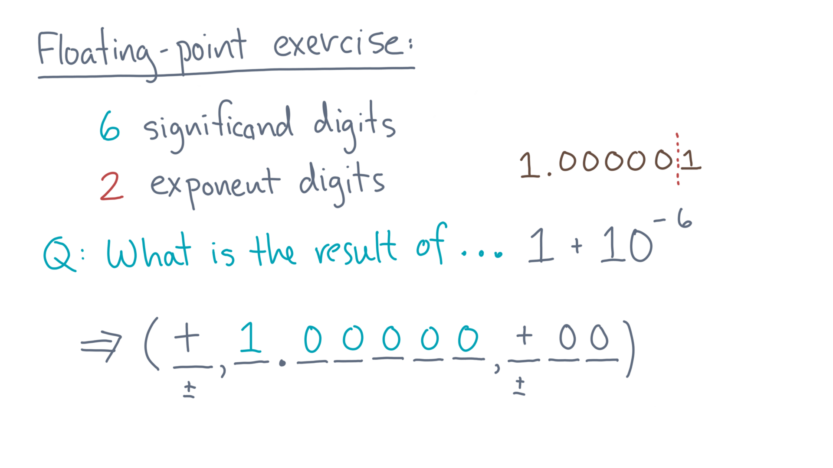
Notes:
That’s the first 6 digits.
So the best we can do is round the result.

Slide 16
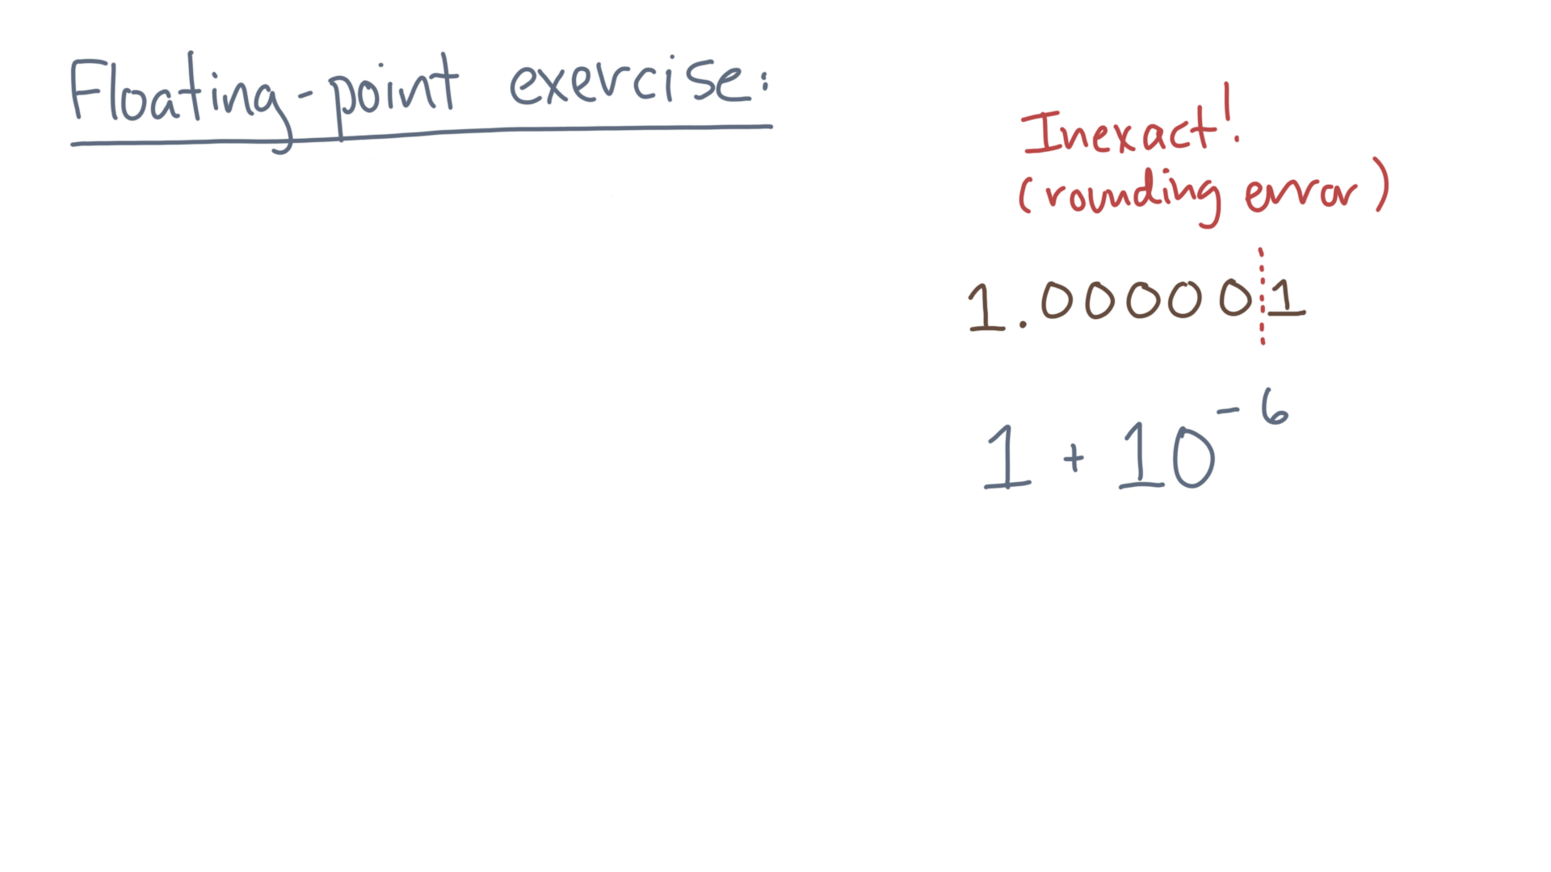
Notes:
In other words, sometimes you simply can’t store the true solution exactly, only some rounded approximation.
This phenomenon of losing digits because of finite-precision is what is known as a rounding or “round-off” error.

Slide 17
Notes:
Rounding errors are a fact of life whenever you are trying to do numerical computation.
It doesn’t mean we can’t still write programs that give good approximations.
But it does suggest that we should try to anticipate or at least learn to diagnose potential problems, which is the main point of this lesson.

